Slide 1
Lecture 18
An Example of Hypothesis Testing

Slide 2
Example
Consider a particular automobile model that currently attains an average fuel efficiency of 10 liters per 100 kilometers. A product research group developed a new fuel injection system (燃油喷射系统) specifically designed to decrease the liters-per-100-kilometers rating. To evaluate the new system, 30 were manufactured, installed in automobiles, and subjected to research-controlled driving tests.

Slide 3
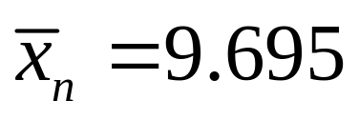
What is your conclusion?
Suppose that the results from driving tests
of the 30 automobiles are as follows:
9.71 8.81 10.20 9.69 11.00
9.26 10.20 9.61 9.58 9.13
9.34 10.70 7.83 9.95 11.00
9.93 9.93 9.30 10.40 9.07
10.00 9.44 10.70 11.50 9.17
6.91 10.10 10.70 8.20 9.50

Slide 4
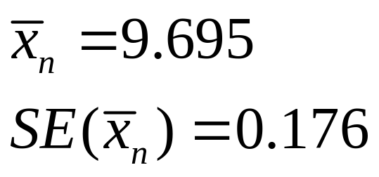
What is your conclusion?
Suppose that the results from driving tests
of the 30 automobiles are as follows:
9.71 8.81 10.20 9.69 11.00
9.26 10.20 9.61 9.58 9.13
9.34 10.70 7.83 9.95 11.00
9.93 9.93 9.30 10.40 9.07
10.00 9.44 10.70 11.50 9.17
6.91 10.10 10.70 8.20 9.50

Slide 5
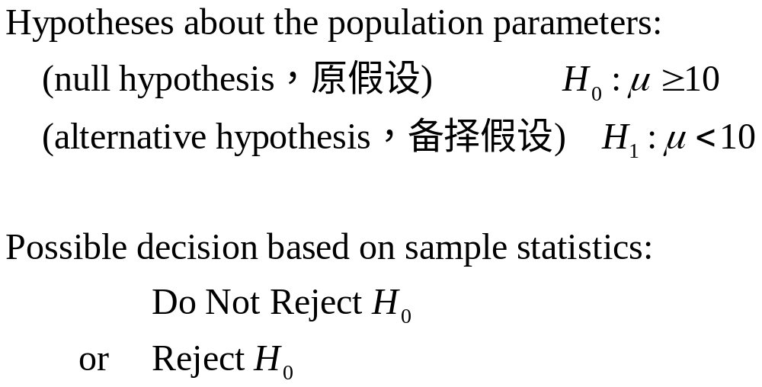
Statistical Inference Type 3:
Hypothesis Testing (假设检验)

Slide 6
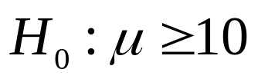
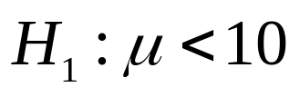

Which decision?
or
30
30

Slide 7
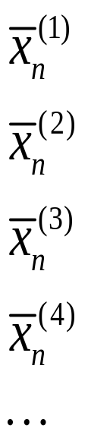
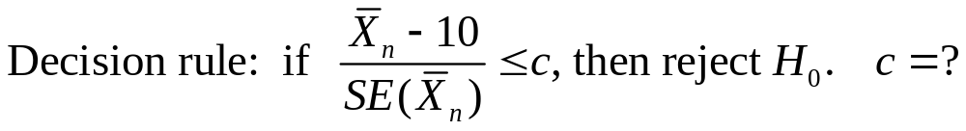
Which decision?
or
30
30
30
30
30
30
30
30

Slide 8
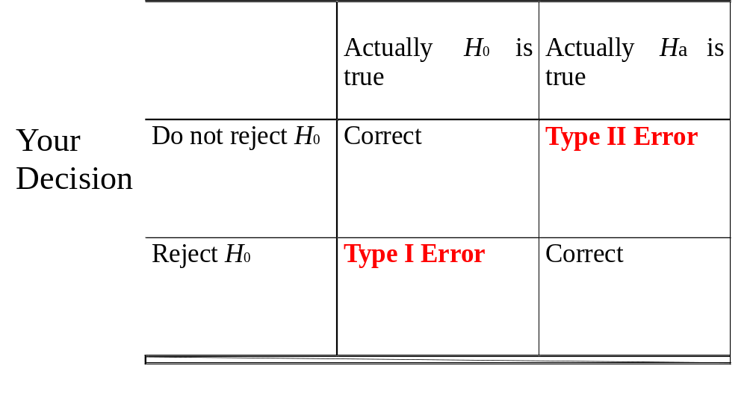
Type I Error (第一类错误) and
Type II Error (第二类错误)
What does it mean?
What’s the consequence?
What does it mean?
What’s the consequence?

Slide 9
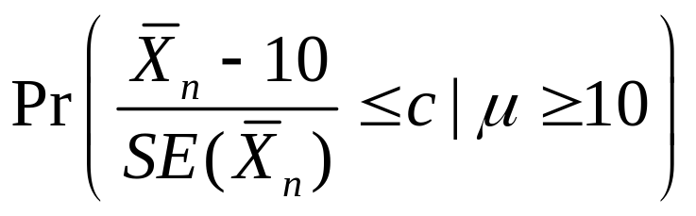
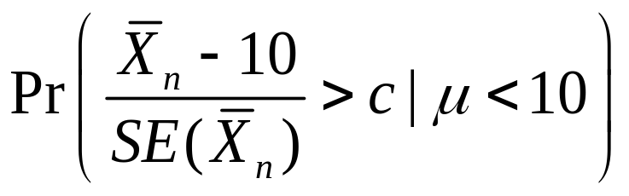
Two Types of Errors
Probability of making Type I error
Probability of making Type II error
Is there a value of c that can avoid both types of errors?

Slide 10
Neymann-Pearson Principle
N-P principle: Control the maximum probability of making Type I error.

Slide 11

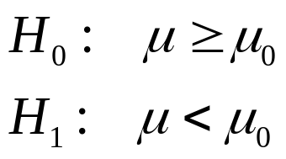
The t Test
Suppose that X1,…,Xn form a random sample from a normal distribution for which both the mean μ and the variance are unknown. Consider testing the hypotheses:

Slide 12
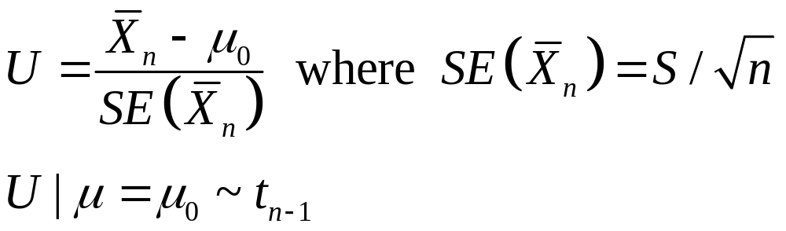

The Critical Value (临界值) Approach
to Hypothesis Testing
Define
We consider the test δ c that rejects H0 if .

Slide 13
Concept: The Critical Region (拒绝域)
Let S denote the sample space of the random vector X=(X1,…,Xn). A test procedure is specified by partitioning the sample space S into two subsets.
  One subset contains the values of X for which H₀ will be not be rejected.
  The other subset contains the values of X for which H₀ will be rejected (critical region).
Determining a test procedure = specifying the critical region of the test.
In the example, the critical region is .

Slide 14

Concept: Test Statistics (检验统计量)
In most hypothesis testing problems, the critical region is defined in terms of a test statistic, T=r(X).
In the example, the test statistic is .

Slide 15

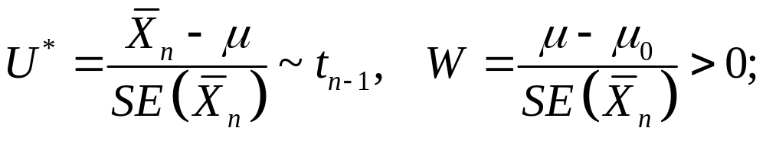
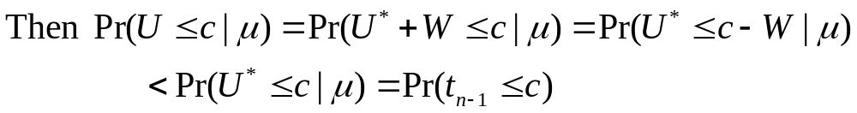
Maximum Probability of Type I Error
If μ=μ0,
For μ>μ0,
Therefore the maximum probability of making type I error happens when the null hypothesis is true as an equality, i.e., when μ=μ0.

Slide 16
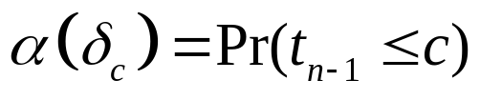
Concept: Size of the Test
The size α(δ) of a given test δ is the maximum probability of type I error .
In the example, .

Slide 17
Concept: Level of Significance (显著性水平)
The level of significance is the maximum probability of type I error that is allowed, and is denoted by α0.

Slide 18
Level of Significance
Common choices for α0 are 0.1, 0.05 or 0.01.
If the cost of making a Type I error is high, is a (larger) (smaller) value of α0 preferred?
If the cost of making a Type I error is not too high, is a (larger) (smaller) value of α0 preferred?

Slide 19

Level α0 test
δ is a level α0 test if and only if .

Slide 20
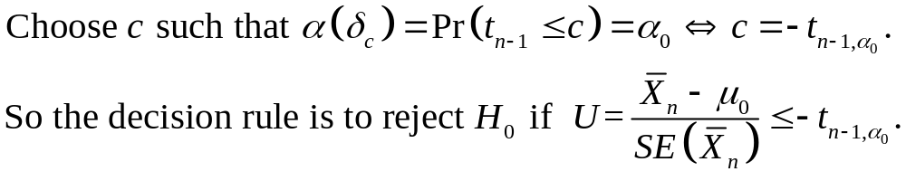
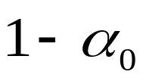


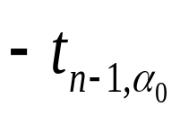


The Critical Value Approach
of all
values

Slide 21
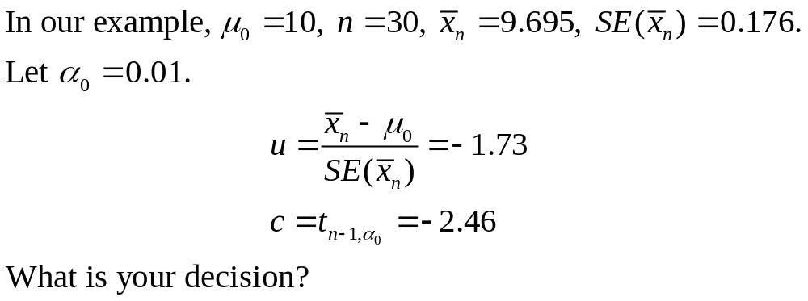

Slide 22
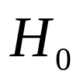
The p-value (p值) Approach to Hypothesis Testing
A p-value is a probability that provides a measure of the evidence against the null hypothesis provided by the sample. Smaller p-values indicate more evidence against .

Slide 23
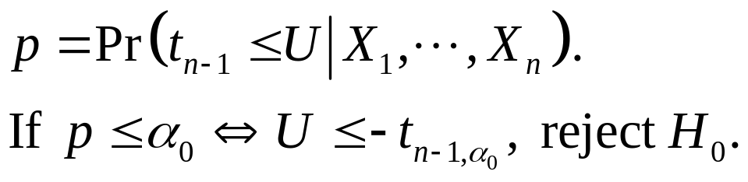
If p<=α0, reject H0
of all
values
p
u

Slide 24
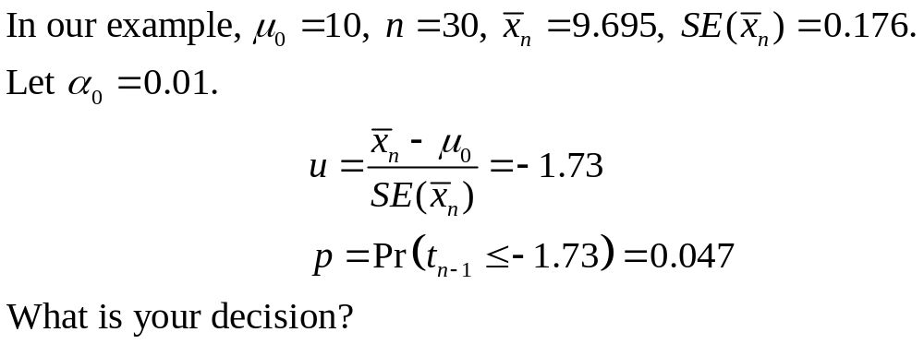

Slide 25
More About p-value
The smallest significance level α0 such that we would reject the null hypothesis H0 at level α0 with the observed data.
The probability of getting a value of the test statistic as extreme as or more extreme than that observed by chance alone if the null hypothesis H0 is true.

Slide 26
Benefit of Using the p-value Approach
p value can be compared with multiple values of α0, and we therefore do not need to specify level of significance at the beginning.
  E.g. p value=0.027, what is the decision when
  α0 =0.01, α0 =0.05?
Hence, p value is standard output in statistical softwares.

Slide 27
Type II Error?
The probability of making Type I error is controlled by level of significance. Type II error, however, is not controlled.
Hence when we cannot reject , we cannot determine how confident we can be with accepting . Statisticians usually recommend that we use the statement “do not reject ” instead of “accept .”

